Slide 1
PSK
1375003
KyungSil Kim
ks_tina@naver.com
Department of Electronics Engineering
Ewha Womans University

Slide 2
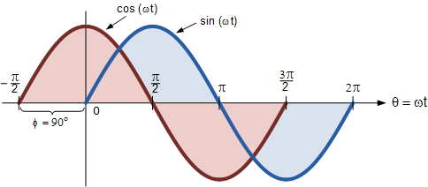

What is the phase difference between sin & cos waves?
$\cos\left(0\right)=1$
$\sin\left(\frac{π}{2}\right)$ = 1
Phase difference = $\frac{π}{2}$

Slide 3
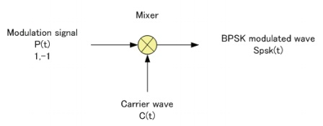
Define your BPSK signal for 0 phase shift.
$$S_{psk}\left(t\right)=P\left(t\right)C\left(t\right)=P(t)A_{c}cos⁡(2πf_{c}t)$$

Slide 4
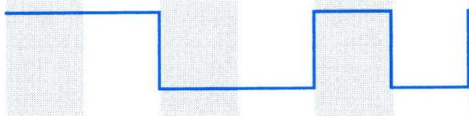
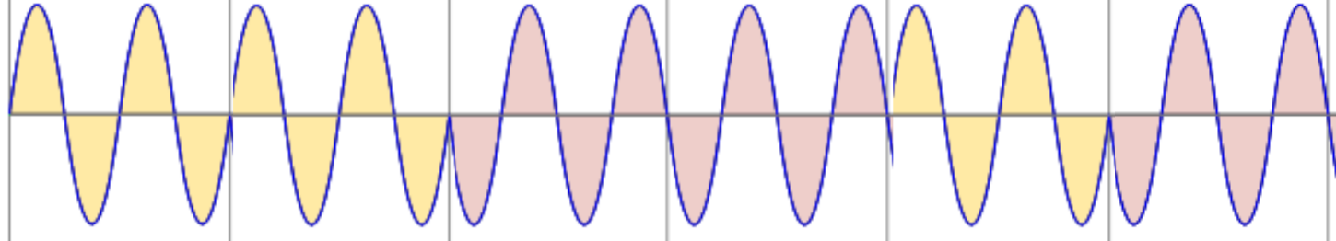

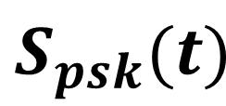

Draw a modulated signal $S_{psk}(t)$ for
P(t) = {1, 1, −1, −1, 1, −1}.
1
1
-1
-1
1
-1
$P(t)$
$S_{psk}(t)$

